Slide 1
SMALL INTESTINE
Dr Reshmy K.R
Professor
Dept.of Physiology
SKHMC

Slide 2
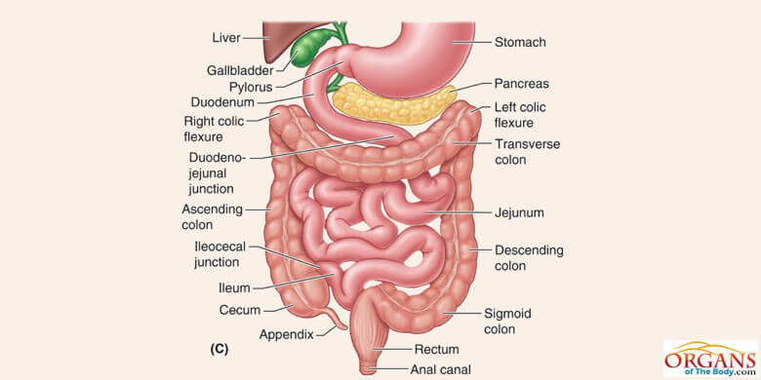
Small Intestine
Starts from the pyloric sphincter at the lower end of the stomach and continues to the beginning of large intestine at the ileocecal junction.
largest partof GI tract-300 cm
Small diameter- 1 inch

Slide 3
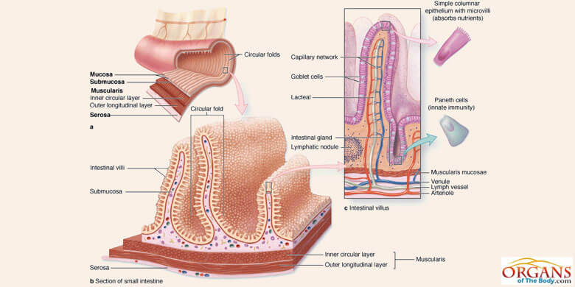
The four layers of small intestine wall mucosa, submucosa, muscularis externa and serosa
Lamina Propria
Lying beneath the epithelium, lamina propria is a thin layer of loose connective tissue to provide nutrition and support to epithelium.
bind the epithelium to the underlying tissue.
contains capillaries, lymphoid tissue and a central lymph vessel.
It is rich in the immune cells, called lymphocytes.
The glands of this layer secrete mucus and serous secretions which enter the lumen through ducts opening on to mucosal epithelium.

Slide 4
Brunner’s glands -(mucus glands) secrete mucus
Protect the duodenal wall from digestion by the highly acidic gastric juice emptying from the stomach.
Mucus contains a large excess of bicarbonate ions, which add to the bicarbonate ions from pancreatic secretion and liver bile in neutralizing the hydrochloric acid entering the duodenum from the stomach.
Inhibited by sympathetic stimulation

Slide 5
Secretion of Intestinal Digestive Juices by the
Crypts of Lieberkühn
Located over the entire surface of the small intestine are small pits called crypts of Lieberkühn
These crypts lie between the intestinal villi.
The surfaces of both the crypts and the villi are covered by an epithelium composed of two types of cells:
(1) a moderate number of goblet cells, which secrete mucus that lubricates and protects the intestinal surfaces,
(2) a large number of enterocytes, in the crypts, secrete large quantities of water and electrolytes
Reabsorb the water and electrolytes along with end products of digestion.

Slide 6
Glands of small intestine-functions
Secrete large amounts of alkaline mucus in response to
(1) Tactile or irritating stimuli on the duodenal mucosa
(2) Vagal stimulation, which causes increased Brunner’s glands secretion concurrently with increase in stomach secretion
(3) Gastrointestinal hormones, especially secretin.

Slide 7
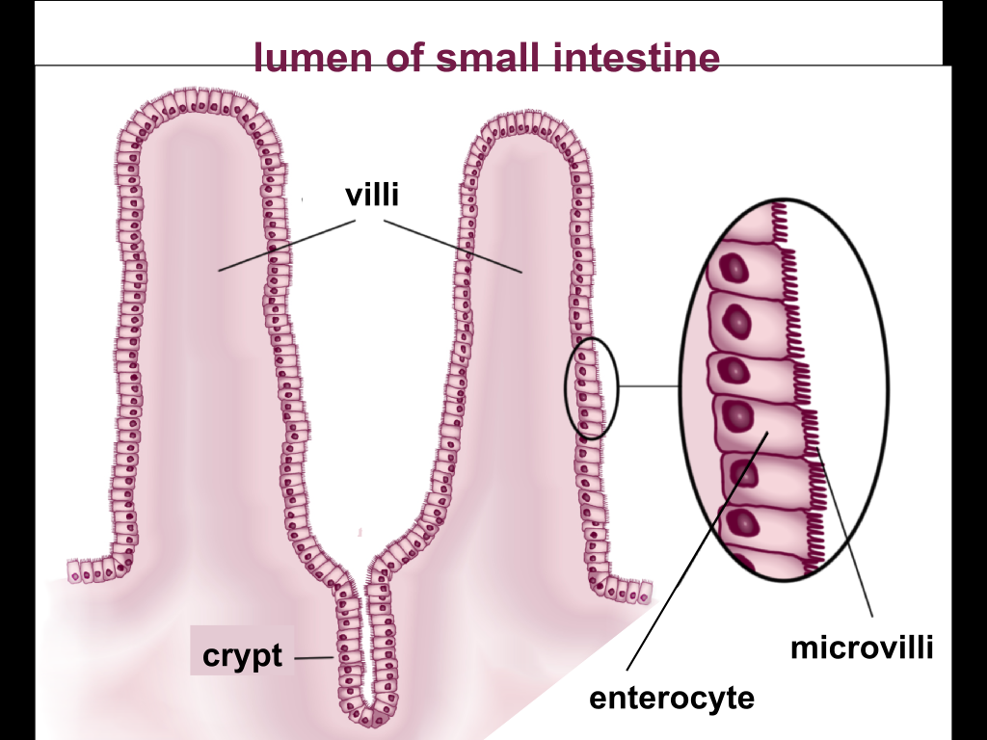
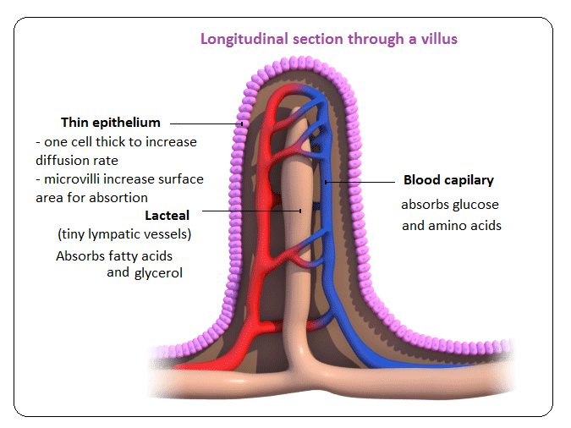
Structure & function of villi
Ht of villi-1mm, dia less than 1mm lined by columnar cells-Enterocytes

Slide 8
Properties& composition of Succus Entericus
The small intestinal (Succus Entericus) secretions are formed by the enterocytes
Rate of formation- 1800 ml/day.
slightly alkaline
pH in the range of 7.5 to 8.0.
Composition
water,organic& inorganic substances
Organic Inorganic
Enzymes Na,Ca,K,Cl,PO₄
SO₄,Hco₃
Intrinsic facor
Mucus

Slide 9
Functions of Succus entericus
1.Chemical digestion
2.Protective function- (action of mucus)
3.Activator function(Enterokinase-Activates Trypsinogen into Trypsin)
4.Hemopoietic function( Role of Intrinsic factor of castle)
5.Hydrolytic function(helps in enzymatic reactions of digestion)

Slide 10
Digestive functions of Succus Entericus
The enterocytes of the mucosa, contain digestive enzymes that digest specific food substances while they are being absorbed through the epithelium.
(1) Peptidases for splitting small peptides into amino acids
(2) sucrase, maltase, isomaltase, and lactase—for splitting disaccharides into monosaccharides
(3) small amounts of intestinal lipase for splitting neutral fats into glycerol and fatty acids.

Slide 11
Functions of Small Intestine
Mechanical function -- mixing movements
Secretory function --succus entericus, enterokinase, GI hormones
Hormonal function--Secretin,Enterogasterone-(hormone which inhibits Gastric secretion& motility), CCK-PZ
Digestive function
Activator function
Hemopoietic function
Hydrolytic function
Absorptive function -- for glucose,Amino acids,Monoglycerides, Cholesterol, fatty acids, water, minerals, vitamins

Slide 12
Regulation of small Intestinal secretion
Local stimuli - local enteric nervous reflexes, especially reflexes initiated by tactile or irritative stimuli from the chyme in the intestines.
Stimulation by Parasympathetic -Vasodilatation & increases the secretion
Stimulation by Sympathetic -Vasoconstriction & decreases the secretion
Hormonal Regulation - Enterocrinin,Secretin, Cholecytokinin helps to promote the secretion of S.E by stimulating the Intestinal glands.

Slide 13
http://www.old-ib.bioninja.com.au/standard-level/topic-6-human-health-and/61-digestion.html https://www.msdmanuals.com/home/digestive-disorders/biology-of-the-digestive-system/small-intestine http://encyclopedia.lubopitko-bg.com/Stomach.html
THANK YOU

